Slide 1
Data Mining:
Concepts and Techniques
(3rd ed.)
— Chapter 10 —
Jiawei Han, Micheline Kamber, and Jian Pei
University of Illinois at Urbana-Champaign &
Simon Fraser University
©2011 Han, Kamber & Pei. All rights reserved.

Slide 2
Chapter 10. Cluster Analysis: Basic Concepts and Methods
Cluster Analysis: Basic Concepts
Partitioning Methods
Hierarchical Methods
Density-Based Methods
Grid-Based Methods
Evaluation of Clustering
Summary

Slide 3
What is Cluster Analysis?
Cluster: A collection of data objects
  similar (or related) to one another within the same group
  dissimilar (or unrelated) to the objects in other groups
Cluster analysis (or clustering, data segmentation, …)
  Finding similarities between data according to the characteristics found in the data and grouping similar data objects into clusters
Unsupervised learning: no predefined classes (i.e., learning by observations vs. learning by examples: supervised)
Typical applications
  As a stand-alone tool to get insight into data distribution
  As a preprocessing step for other algorithms

Slide 4
Clustering for Data Understanding and Applications
Biology: taxonomy of living things: kingdom, phylum, class, order, family, genus and species
Information retrieval: document clustering
Land use: Identification of areas of similar land use in an earth observation database
Marketing: Help marketers discover distinct groups in their customer bases, and then use this knowledge to develop targeted marketing programs
City-planning: Identifying groups of houses according to their house type, value, and geographical location
Earth-quake studies: Observed earth quake epicenters should be clustered along continent faults
Climate: understanding earth climate, find patterns of atmospheric and ocean
Economic Science: market resarch

Slide 5
Clustering as a Preprocessing Tool (Utility)
Summarization:
  Preprocessing for regression, PCA, classification, and association analysis
Compression:
  Image processing: vector quantization
Finding K-nearest Neighbors
  Localizing search to one or a small number of clusters
Outlier detection
  Outliers are often viewed as those “far away” from any cluster

Slide 6
Quality: What Is Good Clustering?
A good clustering method will produce high quality clusters
  high intra-class similarity: cohesive within clusters
  low inter-class similarity: distinctive between clusters
The quality of a clustering method depends on
  the similarity measure used by the method
  its implementation, and
  Its ability to discover some or all of the hidden patterns

Slide 7
Measure the Quality of Clustering
Dissimilarity/Similarity metric
  Similarity is expressed in terms of a distance function, typically metric: d(i, j)
  The definitions of distance functions are usually rather different for interval-scaled, boolean, categorical, ordinal ratio, and vector variables
  Weights should be associated with different variables based on applications and data semantics
Quality of clustering:
  There is usually a separate “quality” function that measures the “goodness” of a cluster.
  It is hard to define “similar enough” or “good enough”
    The answer is typically highly subjective

Slide 8
Considerations for Cluster Analysis
Partitioning criteria
  Single level vs. hierarchical partitioning (often, multi-level hierarchical partitioning is desirable)
Separation of clusters
  Exclusive (e.g., one customer belongs to only one region) vs. non-exclusive (e.g., one document may belong to more than one class)
Similarity measure
  Distance-based (e.g., Euclidian, road network, vector) vs. connectivity-based (e.g., density or contiguity)
Clustering space
  Full space (often when low dimensional) vs. subspaces (often in high-dimensional clustering)

Slide 9
Requirements and Challenges
Scalability
  Clustering all the data instead of only on samples
Ability to deal with different types of attributes
  Numerical, binary, categorical, ordinal, linked, and mixture of these
Constraint-based clustering
    User may give inputs on constraints
    Use domain knowledge to determine input parameters
Interpretability and usability
Others
  Discovery of clusters with arbitrary shape
  Ability to deal with noisy data
  Incremental clustering and insensitivity to input order
  High dimensionality

Slide 10
Major Clustering Approaches (I)
Partitioning approach:
  Construct various partitions and then evaluate them by some criterion, e.g., minimizing the sum of square errors
  Typical methods: k-means, k-medoids, CLARANS
Hierarchical approach:
  Create a hierarchical decomposition of the set of data (or objects) using some criterion
  Typical methods: Diana, Agnes, BIRCH, CAMELEON
Density-based approach:
  Based on connectivity and density functions
  Typical methods: DBSACN, OPTICS, DenClue
Grid-based approach:
  based on a multiple-level granularity structure
  Typical methods: STING, WaveCluster, CLIQUE

Slide 11
Major Clustering Approaches (II)
Model-based:
  A model is hypothesized for each of the clusters and tries to find the best fit of that model to each other
  Typical methods: EM, SOM, COBWEB
Frequent pattern-based:
  Based on the analysis of frequent patterns
  Typical methods: p-Cluster
User-guided or constraint-based:
  Clustering by considering user-specified or application-specific constraints
  Typical methods: COD (obstacles), constrained clustering
Link-based clustering:
  Objects are often linked together in various ways
  Massive links can be used to cluster objects: SimRank, LinkClus

Slide 12
Chapter 10. Cluster Analysis: Basic Concepts and Methods
Cluster Analysis: Basic Concepts
Partitioning Methods
Hierarchical Methods
Density-Based Methods
Grid-Based Methods
Evaluation of Clustering
Summary

Slide 13

Partitioning Algorithms: Basic Concept
Partitioning method: Partitioning a database D of n objects into a set of k clusters, such that the sum of squared distances is minimized (where c_{i} is the centroid or medoid of cluster C_{i})
Given k, find a partition of k clusters that optimizes the chosen partitioning criterion
  Global optimal: exhaustively enumerate all partitions
  Heuristic methods: k-means and k-medoids algorithms
  k-means (MacQueen’67, Lloyd’57/’82): Each cluster is represented by the center of the cluster
  k-medoids or PAM (Partition around medoids) (Kaufman & Rousseeuw’87): Each cluster is represented by one of the objects in the cluster

Slide 14
The K-Means Clustering Method
Given k, the k-means algorithm is implemented in four steps:
  Partition objects into k nonempty subsets
  Compute seed points as the centroids of the clusters of the current partitioning (the centroid is the center, i.e., mean point, of the cluster)
  Assign each object to the cluster with the nearest seed point
  Go back to Step 2, stop when the assignment does not change

Slide 15





An Example of K-Means Clustering
K=2
Arbitrarily partition objects into k groups
Update the cluster centroids
The initial data set
Loop if needed
Reassign objects
Partition objects into k nonempty subsets
Repeat
  Compute centroid (i.e., mean point) for each partition
  Assign each object to the cluster of its nearest centroid
Until no change
Update the cluster centroids

Slide 16
Comments on the K-Means Method
Strength: Efficient: O(tkn), where n is # objects, k is # clusters, and t is # iterations. Normally, k, t << n.
    Comparing: PAM: O(k(n-k)² ), CLARA: O(ks² + k(n-k))
Comment: Often terminates at a local optimal.
Weakness
  Applicable only to objects in a continuous n-dimensional space
    Using the k-modes method for categorical data
    In comparison, k-medoids can be applied to a wide range of data
  Need to specify k, the number of clusters, in advance (there are ways to automatically determine the best k (see Hastie et al., 2009)
  Sensitive to noisy data and outliers
  Not suitable to discover clusters with non-convex shapes

Slide 17

Variations of the K-Means Method
Most of the variants of the k-means which differ in
  Selection of the initial k means
  Dissimilarity calculations
  Strategies to calculate cluster means
Handling categorical data: k-modes
  Replacing means of clusters with modes
  Using new dissimilarity measures to deal with categorical objects
  Using a frequency-based method to update modes of clusters
  A mixture of categorical and numerical data: k-prototype method

Slide 18
What Is the Problem of the K-Means Method?
The k-means algorithm is sensitive to outliers !
  Since an object with an extremely large value may substantially distort the distribution of the data
K-Medoids: Instead of taking the mean value of the object in a cluster as a reference point, medoids can be used, which is the most centrally located object in a cluster
10
10
9
9
8
8
7
7
6
6
5
5
4
4
3
3
2
2
1
1
0
0
1
2
3
4
5
6
7
8
9
10
0
0
1
2
3
4
5
6
7
8
9
10

Slide 19

PAM: A Typical K-Medoids Algorithm
Total Cost = 20
10
9
8
Arbitrary choose k object as initial medoids
Assign each remaining object to nearest medoids
7
6
5
4
3
2
1
0
0
1
2
3
4
5
6
7
8
9
10
K=2
Randomly select a nonmedoid object,O_{ramdom}
Total Cost = 26
Do loop
Until no change
10
10
9
Compute total cost of swapping
9
Swapping O and O_{ramdom}
If quality is improved.
8
8
7
7
6
6
5
5
4
4
3
3
2
2
1
1
0
0
1
2
3
4
5
6
7
8
9
10
0
0
1
2
3
4
5
6
7
8
9
10

Slide 20
The K-Medoid Clustering Method
K-Medoids Clustering: Find representative objects (medoids) in clusters
  PAM (Partitioning Around Medoids, Kaufmann & Rousseeuw 1987)
    Starts from an initial set of medoids and iteratively replaces one of the medoids by one of the non-medoids if it improves the total distance of the resulting clustering
    PAM works effectively for small data sets, but does not scale well for large data sets (due to the computational complexity)
Efficiency improvement on PAM
  CLARA (Kaufmann & Rousseeuw, 1990): PAM on samples
  CLARANS (Ng & Han, 1994): Randomized re-sampling

Slide 21
Chapter 10. Cluster Analysis: Basic Concepts and Methods
Cluster Analysis: Basic Concepts
Partitioning Methods
Hierarchical Methods
Density-Based Methods
Grid-Based Methods
Evaluation of Clustering
Summary

Slide 22
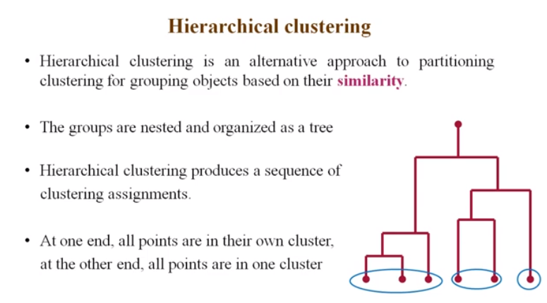

Slide 23
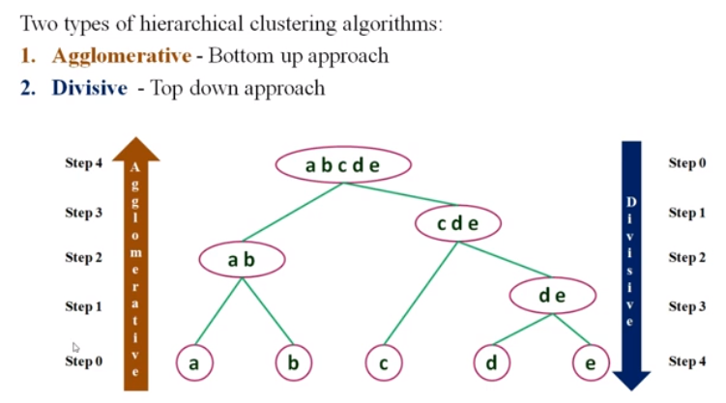

Slide 24
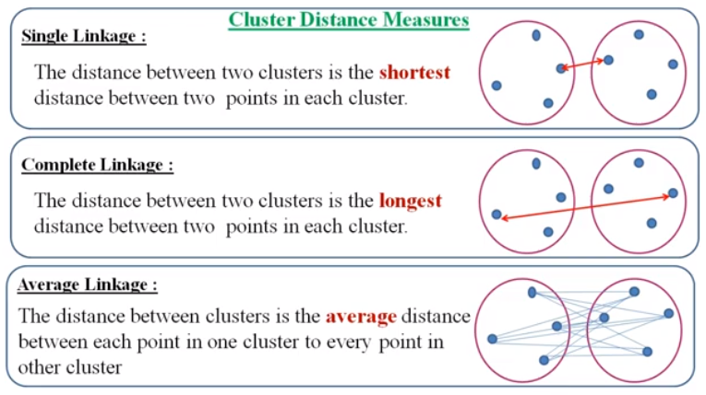

Slide 25
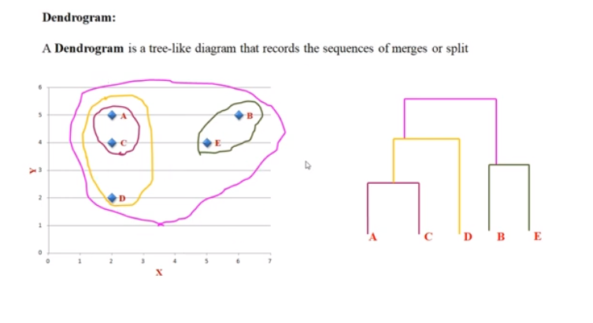

Slide 26
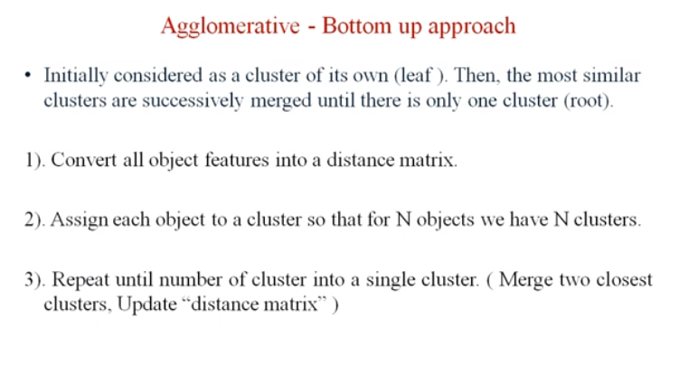

Slide 27
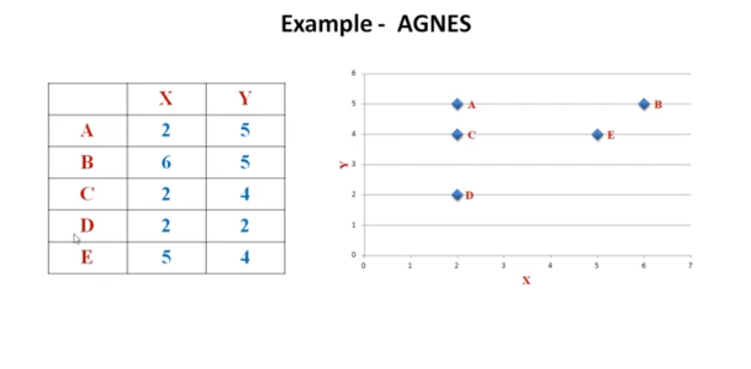

Slide 28
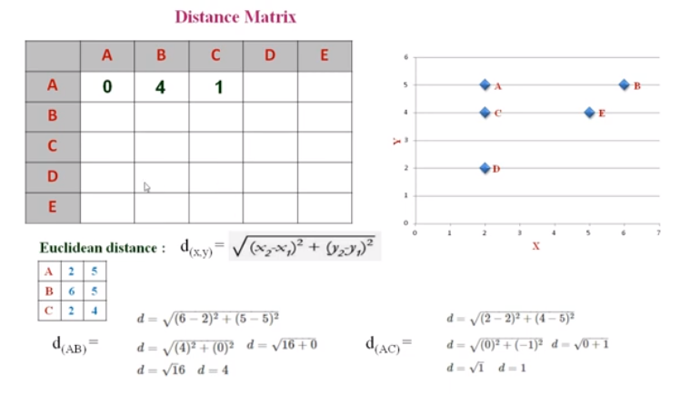
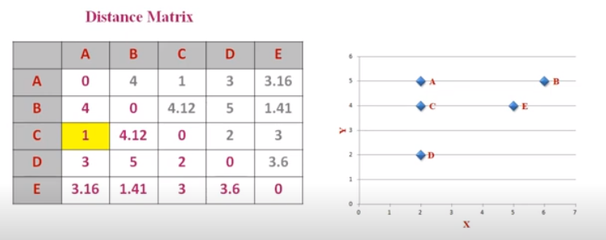
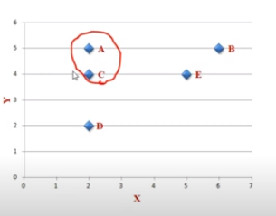

Slide 29
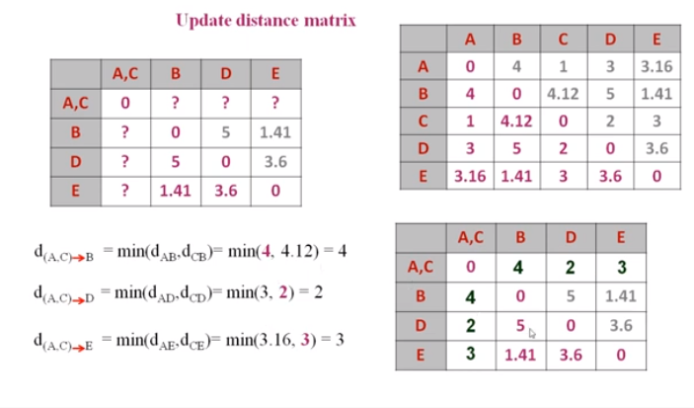

Slide 30
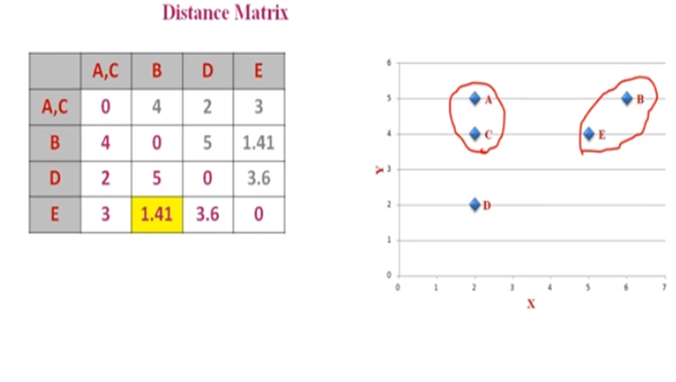

Slide 31
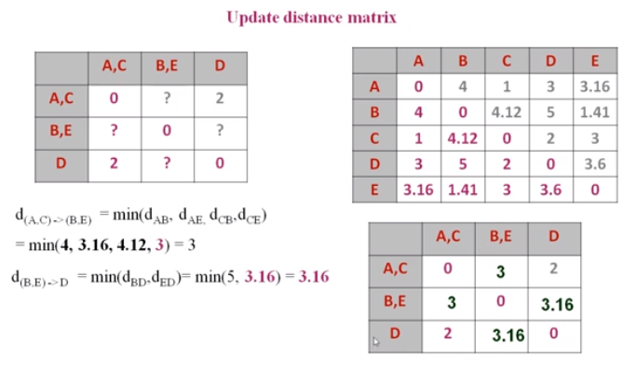

Slide 32
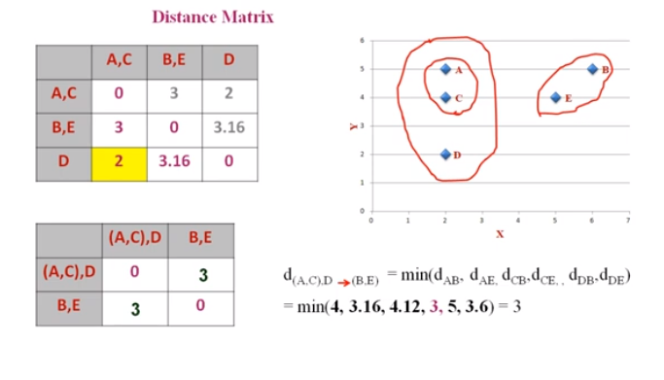

Slide 33
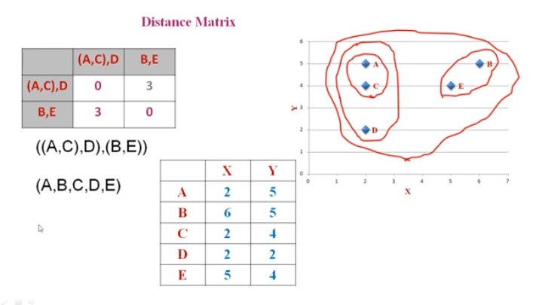

Slide 34
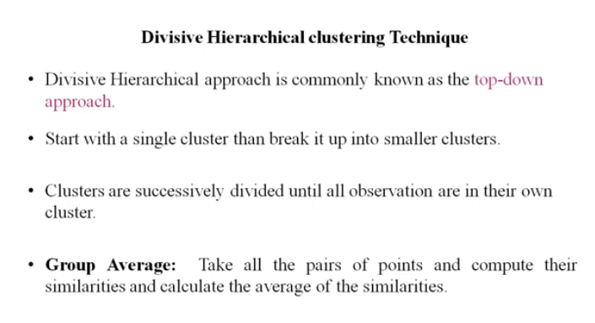

Slide 35
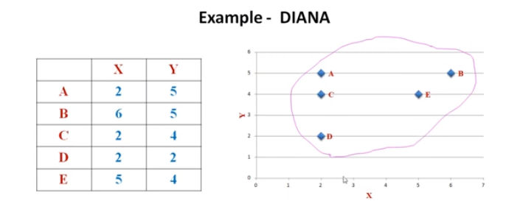
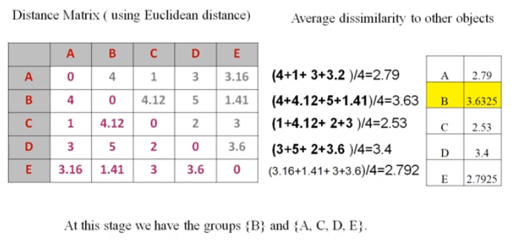

Slide 36
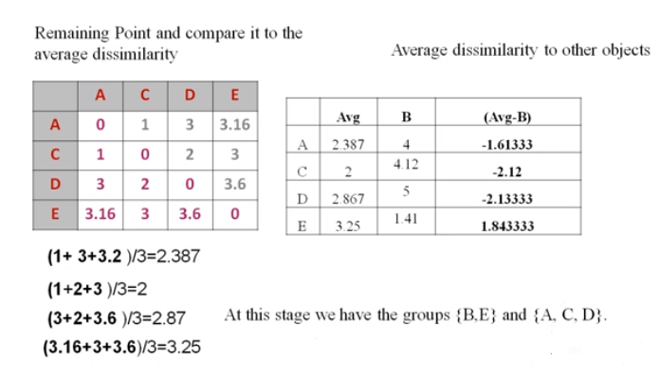

Slide 37
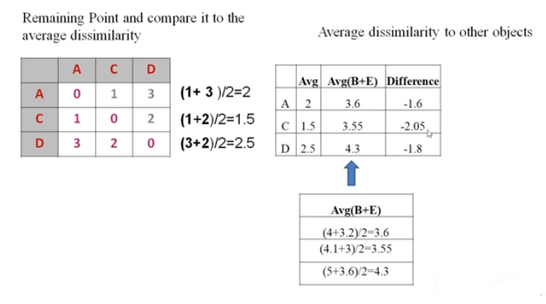
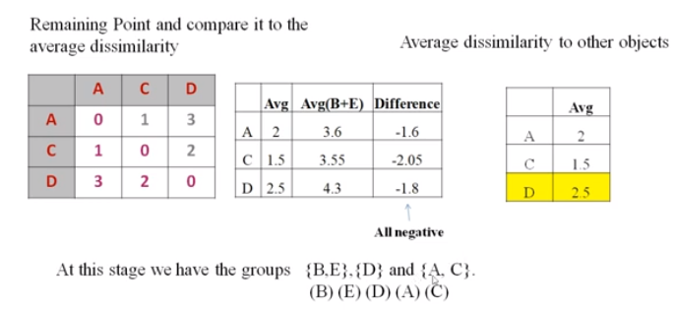
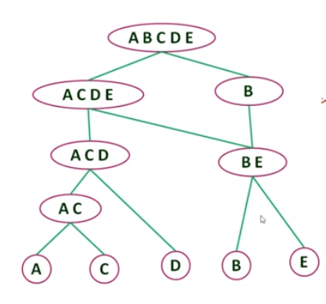

Slide 38

DIANA (Divisive Analysis)
Introduced in Kaufmann and Rousseeuw (1990)
Implemented in statistical analysis packages, e.g., Splus
Inverse order of AGNES
Eventually each node forms a cluster on its own

Slide 39
Distance between Clusters
X
X
Single link: smallest distance between an element in one cluster and an element in the other, i.e., dist(K_{i}, K_{j}) = min(t_{ip}, t_{jq})
Complete link: largest distance between an element in one cluster and an element in the other, i.e., dist(K_{i}, K_{j}) = max(t_{ip}, t_{jq})
Average: avg distance between an element in one cluster and an element in the other, i.e., dist(K_{i}, K_{j}) = avg(t_{ip}, t_{jq})
Centroid: distance between the centroids of two clusters, i.e., dist(K_{i}, K_{j}) = dist(C_{i}, C_{j})
Medoid: distance between the medoids of two clusters, i.e., dist(K_{i}, K_{j}) = dist(M_{i}, M_{j})
  Medoid: a chosen, centrally located object in the cluster

Slide 40



Centroid, Radius and Diameter of a Cluster (for numerical data sets)
Centroid: the “middle” of a cluster
Radius: square root of average distance from any point of the cluster to its centroid
Diameter: square root of average mean squared distance between all pairs of points in the cluster

Slide 41
Extensions to Hierarchical Clustering
Major weakness of agglomerative clustering methods
  Can never undo what was done previously
  Do not scale well: time complexity of at least O(n²), where n is the number of total objects
Integration of hierarchical & distance-based clustering
  BIRCH (1996): uses CF-tree and incrementally adjusts the quality of sub-clusters
  CHAMELEON (1999): hierarchical clustering using dynamic modeling

Slide 42
BIRCH (Balanced Iterative Reducing and Clustering Using Hierarchies)
Zhang, Ramakrishnan & Livny, SIGMOD’96
Incrementally construct a CF (Clustering Feature) tree, a hierarchical data structure for multiphase clustering
  Phase 1: scan DB to build an initial in-memory CF tree (a multi-level compression of the data that tries to preserve the inherent clustering structure of the data)
  Phase 2: use an arbitrary clustering algorithm to cluster the leaf nodes of the CF-tree
Scales linearly: finds a good clustering with a single scan and improves the quality with a few additional scans
Weakness: handles only numeric data, and sensitive to the order of the data record

Slide 43
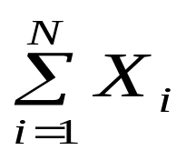
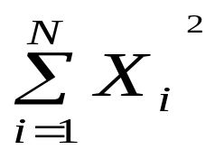
Clustering Feature Vector in BIRCH
Clustering Feature (CF): CF = (N, LS, SS)
N: Number of data points
LS: linear sum of N points:
SS: square sum of N points
CF = (5, (16,30),(54,190))
(3,4)
(2,6)
(4,5)
(4,7)
(3,8)

Slide 44

CF-Tree in BIRCH
Clustering feature:
  Summary of the statistics for a given subcluster: the 0-th, 1st, and 2nd moments of the subcluster from the statistical point of view
  Registers crucial measurements for computing cluster and utilizes storage efficiently
A CF tree is a height-balanced tree that stores the clustering features for a hierarchical clustering
  A nonleaf node in a tree has descendants or “children”
  The nonleaf nodes store sums of the CFs of their children
A CF tree has two parameters
  Branching factor: max # of children
  Threshold: max diameter of sub-clusters stored at the leaf nodes

Slide 45
The CF Tree Structure
Root
B = 7
L = 6
CF₁
CF₂
CF₃
CF₆
child₁
child₂
child₃
child₆
Non-leaf node
CF₁
CF₂
CF₃
CF₅
child₁
child₂
child₃
child₅
Leaf node
Leaf node
prev
CF₁
CF₂
CF₆
next
prev
CF₁
CF₂
CF₄
next

Slide 46
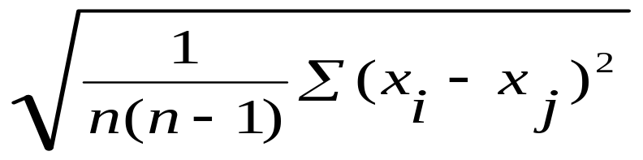
The Birch Algorithm
Cluster Diameter
For each point in the input
  Find closest leaf entry
  Add point to leaf entry and update CF
  If entry diameter > max_diameter, then split leaf, and possibly parents
Algorithm is O(n)
Concerns
  Sensitive to insertion order of data points
  Since we fix the size of leaf nodes, so clusters may not be so natural
  Clusters tend to be spherical given the radius and diameter measures

Slide 47
Chapter 10. Cluster Analysis: Basic Concepts and Methods
Cluster Analysis: Basic Concepts
Partitioning Methods
Hierarchical Methods
Density-Based Methods
Grid-Based Methods
Evaluation of Clustering
Summary

Slide 48
Density-Based Clustering Methods
Clustering based on density (local cluster criterion), such as density-connected points
Major features:
  Discover clusters of arbitrary shape
  Handle noise
  One scan
  Need density parameters as termination condition
Several interesting studies:
  DBSCAN: Ester, et al. (KDD’96)
  OPTICS: Ankerst, et al (SIGMOD’99).
  DENCLUE: Hinneburg & D. Keim (KDD’98)
  CLIQUE: Agrawal, et al. (SIGMOD’98) (more grid-based)

Slide 49
Density-Based Clustering: Basic Concepts
Two parameters:
  Eps: Maximum radius of the neighbourhood
  MinPts: Minimum number of points in an Eps-neighbourhood of that point
N_{Eps}(p): {q belongs to D | dist(p,q) ≤ Eps}
Directly density-reachable: A point p is directly density-reachable from a point q w.r.t. Eps, MinPts if
  p belongs to N_{Eps}(q)
  core point condition:
  |N_{Eps} (q)| ≥ MinPts
p
MinPts = 5
Eps = 1 cm
q

Slide 50
Density-Reachable and Density-Connected
Density-reachable:
  A point p is density-reachable from a point q w.r.t. Eps, MinPts if there is a chain of points p₁, …, p_{n}, p₁ = q, p_{n} = p such that p_{i+1} is directly density-reachable from p_{i}
Density-connected
  A point p is density-connected to a point q w.r.t. Eps, MinPts if there is a point o such that both, p and q are density-reachable from o w.r.t. Eps and MinPts
p
p₁
q
p
q
o

Slide 51
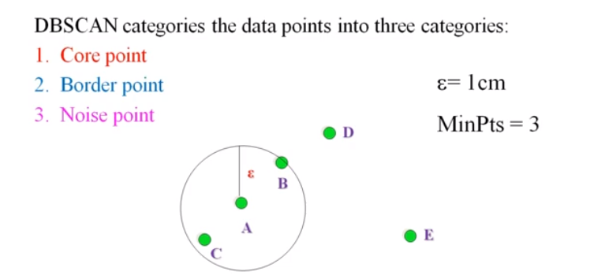
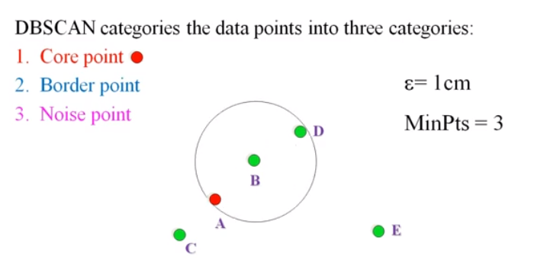
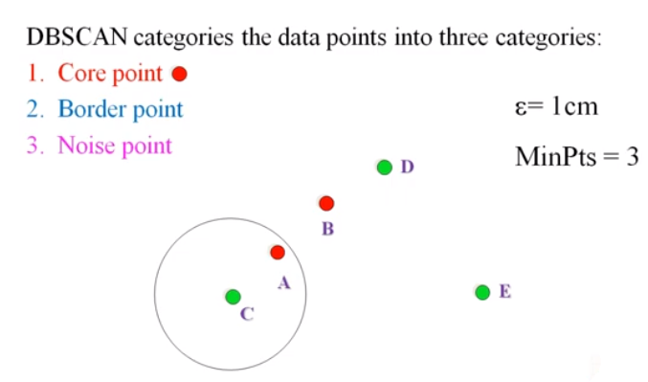
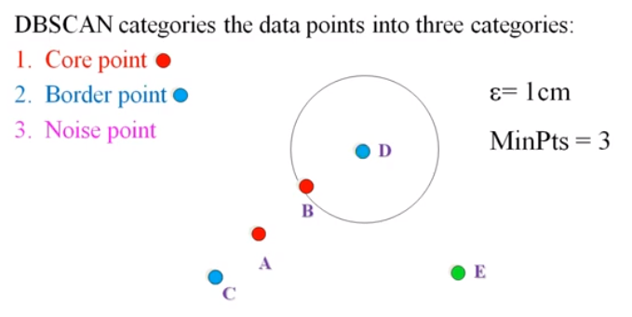

Slide 52
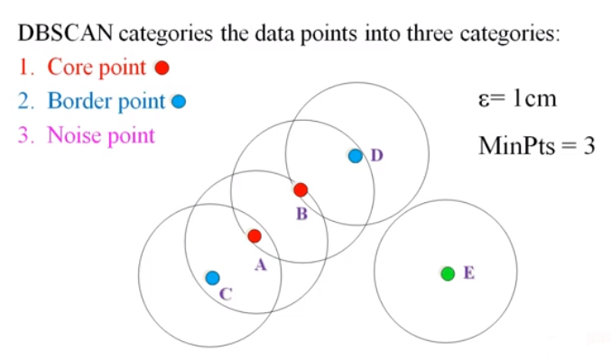
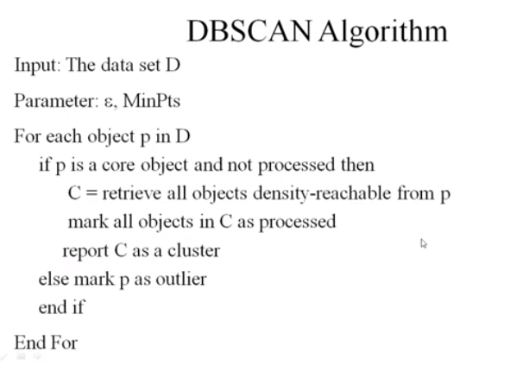

Slide 53
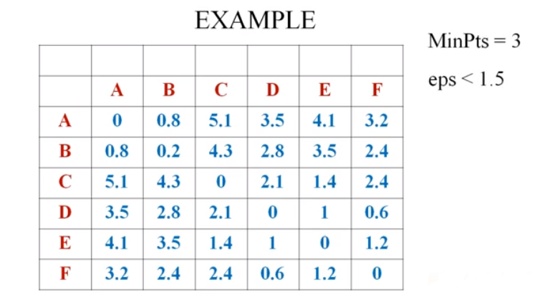
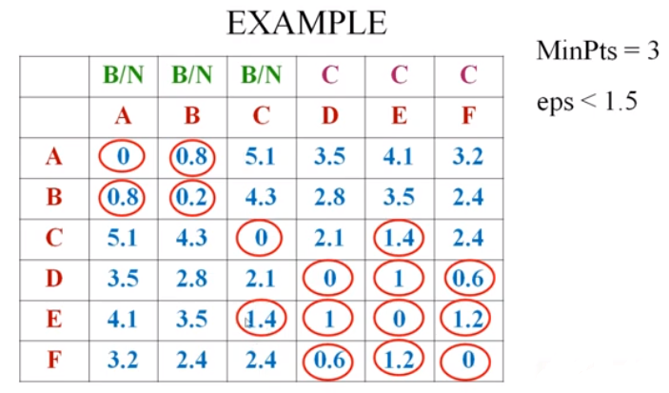
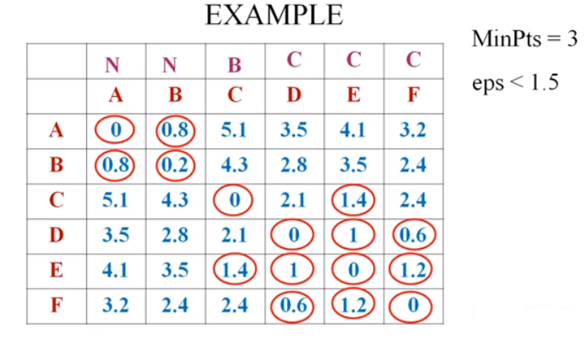

Slide 54
DBSCAN: Density-Based Spatial Clustering of Applications with Noise
Relies on a density-based notion of cluster: A cluster is defined as a maximal set of density-connected points
Discovers clusters of arbitrary shape in spatial databases with noise
Outlier
Border
Eps = 1cm
MinPts = 5
Core

Slide 55
Chapter 10. Cluster Analysis: Basic Concepts and Methods
Cluster Analysis: Basic Concepts
Partitioning Methods
Hierarchical Methods
Density-Based Methods
Grid-Based Methods
Evaluation of Clustering
Summary

Slide 56
Grid-Based Clustering Method
Using multi-resolution grid data structure
Several interesting methods
  STING (a STatistical INformation Grid approach) by Wang, Yang and Muntz (1997)
  CLIQUE: Agrawal, et al. (SIGMOD’98)
    Both grid-based and subspace clustering

Slide 57

STING: A Statistical Information Grid Approach
Wang, Yang and Muntz (VLDB’97)
The spatial area is divided into rectangular cells
There are several levels of cells corresponding to different levels of resolution

Slide 58
The STING Clustering Method
Each cell at a high level is partitioned into a number of smaller cells in the next lower level
Statistical info of each cell is calculated and stored before hand and is used to answer queries
Parameters of higher level cells can be easily calculated from parameters of lower level cell
  count, mean, s, min, max
  type of distribution—normal, uniform, etc.
Use a top-down approach to answer spatial data queries
Start from a pre-selected layer—typically with a small number of cells
For each cell in the current level compute the confidence interval

Slide 59
STING Algorithm and Its Analysis
Remove the irrelevant cells from further consideration
When finish examining the current layer, proceed to the next lower level
Repeat this process until the bottom layer is reached
Advantages:
  Query-independent, easy to parallelize, incremental update
  O(K), where K is the number of grid cells at the lowest level
Disadvantages:
  All the cluster boundaries are either horizontal or vertical, and no diagonal boundary is detected

Slide 60
CLIQUE (Clustering In QUEst)
Agrawal, Gehrke, Gunopulos, Raghavan (SIGMOD’98)
Automatically identifying subspaces of a high dimensional data space that allow better clustering than original space
CLIQUE can be considered as both density-based and grid-based
  It partitions each dimension into the same number of equal length interval
  It partitions an m-dimensional data space into non-overlapping rectangular units
  A unit is dense if the fraction of total data points contained in the unit exceeds the input model parameter
  A cluster is a maximal set of connected dense units within a subspace

Slide 61
CLIQUE: The Major Steps
Partition the data space and find the number of points that lie inside each cell of the partition.
Identify the subspaces that contain clusters using the Apriori principle
Identify clusters
  Determine dense units in all subspaces of interests
  Determine connected dense units in all subspaces of interests.
Generate minimal description for the clusters
  Determine maximal regions that cover a cluster of connected dense units for each cluster
  Determination of minimal cover for each cluster

Slide 62
Salary (10,000)
Vacation(week)
7
7
6
6
5
5
4
4
3
3
2
2
1
1
0
age
0
age
20
30
40
50
60
20
30
40
50
60
τ = 3
Vacation
Salary
30
50
age

Slide 63
Strength and Weakness of CLIQUE
Strength
  automatically finds subspaces of the highest dimensionality such that high density clusters exist in those subspaces
  insensitive to the order of records in input and does not presume some canonical data distribution
  scales linearly with the size of input and has good scalability as the number of dimensions in the data increases
Weakness
  The accuracy of the clustering result may be degraded at the expense of simplicity of the method

Slide 64
Chapter 10. Cluster Analysis: Basic Concepts and Methods
Cluster Analysis: Basic Concepts
Partitioning Methods
Hierarchical Methods
Density-Based Methods
Grid-Based Methods
Evaluation of Clustering
Summary

Slide 65

Assessing Clustering Tendency
Assess if non-random structure exists in the data by measuring the probability that the data is generated by a uniform data distribution
Test spatial randomness by statistic test: Hopkins Static
  Given a dataset D regarded as a sample of a random variable o, determine how far away o is from being uniformly distributed in the data space
  Sample n points, p₁, …, p_{n}, uniformly from D. For each p_{i}, find its nearest neighbor in D: x_{i} = min{dist (p_{i}, v)} where v in D
  Sample n points, q₁, …, q_{n}, uniformly from D. For each q_{i}, find its nearest neighbor in D – {q_{i}}: y_{i} = min{dist (q_{i}, v)} where v in D and v ≠ q_{i}
  Calculate the Hopkins Statistic:
  If D is uniformly distributed, ∑ x_{i} and ∑ y_{i} will be close to each other and H is close to 0.5. If D is highly skewed, H is close to 0

Slide 66
Determine the Number of Clusters
Empirical method
  # of clusters ≈√n/2 for a dataset of n points
Elbow method
  Use the turning point in the curve of sum of within cluster variance w.r.t the # of clusters
Cross validation method
  Divide a given data set into m parts
  Use m – 1 parts to obtain a clustering model
  Use the remaining part to test the quality of the clustering
    E.g., For each point in the test set, find the closest centroid, and use the sum of squared distance between all points in the test set and the closest centroids to measure how well the model fits the test set
  For any k > 0, repeat it m times, compare the overall quality measure w.r.t. different k’s, and find # of clusters that fits the data the best

Slide 67
Measuring Clustering Quality
Two methods: extrinsic vs. intrinsic
Extrinsic: supervised, i.e., the ground truth is available
  Compare a clustering against the ground truth using certain clustering quality measure
  Ex. BCubed precision and recall metrics
Intrinsic: unsupervised, i.e., the ground truth is unavailable
  Evaluate the goodness of a clustering by considering how well the clusters are separated, and how compact the clusters are
  Ex. Silhouette coefficient

Slide 68
Measuring Clustering Quality: Extrinsic Methods
Clustering quality measure: Q(C, C_{g}), for a clustering C given the ground truth C_{g}.
Q is good if it satisfies the following 4 essential criteria
  Cluster homogeneity: the purer, the better
  Cluster completeness: should assign objects belong to the same category in the ground truth to the same cluster
  Rag bag: putting a heterogeneous object into a pure cluster should be penalized more than putting it into a rag bag (i.e., “miscellaneous” or “other” category)
  Small cluster preservation: splitting a small category into pieces is more harmful than splitting a large category into pieces

Slide 69
Chapter 10. Cluster Analysis: Basic Concepts and Methods
Cluster Analysis: Basic Concepts
Partitioning Methods
Hierarchical Methods
Density-Based Methods
Grid-Based Methods
Evaluation of Clustering
Summary

Slide 70
Summary
Cluster analysis groups objects based on their similarity and has wide applications
Measure of similarity can be computed for various types of data
Clustering algorithms can be categorized into partitioning methods, hierarchical methods, density-based methods, grid-based methods, and model-based methods
K-means and K-medoids algorithms are popular partitioning-based clustering algorithms
Birch and Chameleon are interesting hierarchical clustering algorithms, and there are also probabilistic hierarchical clustering algorithms
DBSCAN, OPTICS, and DENCLU are interesting density-based algorithms
STING and CLIQUE are grid-based methods, where CLIQUE is also a subspace clustering algorithm
Quality of clustering results can be evaluated in various ways

